Slide 1
The role of gender in ICT-mediated agricultural information campaigns
Some early results from an ongoing field experiment in Uganda
Bjorn Van Campenhout (with E. Lecoutere and D. J. Spielman)
DSG, International Food Policy Research Institute

Slide 2
Introduction
Poor often lack critical pieces of information, fail to notice, or hold beliefs that are not true
Also in agriculture: Information => adoption behaviour
Seemingly small design attributes can make a big difference in effectiveness of information campaigns
We zoom in on gender attributes in agricultural extension information campaigns

Slide 3
Research Hypotheses
Problem: Agricultural extension information = male biased
Change gender (composition) of person(s) targeted by the information & gender (composition) of person(s) delivering the information to test importance of:
Information asymmetries within the household (Lambrecht et al 2016)
Projecting a cooperative approach to farming
Homophily/gender matching (Kondylis et al 2016)
Do agricultural extension information messages work?

Slide 4
Experimental Design – 3^2 factorial design
 |  | Messenger
 |  | Male | Female | couple
Recipient | Male | 385 | 385 | 369
 | Female | 385 | 385 | 369
 | Couple | 342 | 342 | 369
Ctrl
257

Slide 5
Q: Does information message work?
 |  | Messenger
 |  | Male | Female | couple
Recipient | Male | 342 | 342 | 342
 | Female | 342 | 342 | 342
 | Couple | 342 | 342 | 342
Ctrl
257

Slide 6
Q: Is message more effective if couple is targeted?
 |  | Messenger
 |  | Male | Female | couple
Recipient | Male | 369 | 369 | 369
 | Female | 369 | 369 | 369
 | Couple | 342 | 342 | 342

Slide 7
Q: Is information more effective if brought by a couple?
 |  | Messenger
 |  | Male | Female | couple
Recipient | Male | 342 | 342 | 369
 | Female | 342 | 342 | 369
 | Couple | 342 | 342 | 369

Slide 8
Q: Is information more effective if gender recipient -messenger is matched?
 |  | Messenger
 |  | Male | Female | couple
Recipient | Male | 385 | 385
 | Female | 385 | 385
 | Couple

Slide 9
Application: Maize farmers in Uganda
Maize = key staple and cash crop in region
Average yields 620 kg/ac – on-station 1600 kg/ac
Limited use of modern inputs (2.5 kg/ac inorganic fertilizer), low adoption of modern agricultural practices
Limited access to agricultural extension information (about 20 percent of farmers)
1st treat + baseline
Listing
2nd treat
endline
Jun
Aug
Sept
Oct
Nov
Dec
Jan

Slide 10
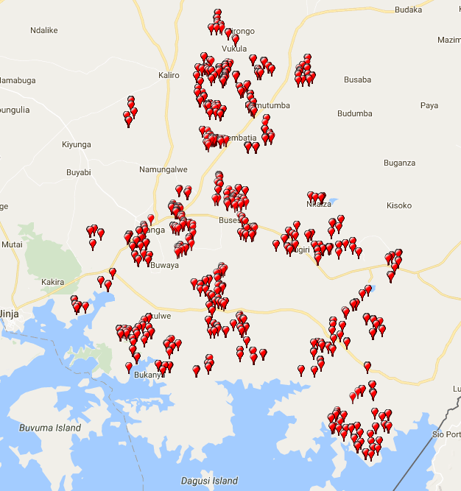
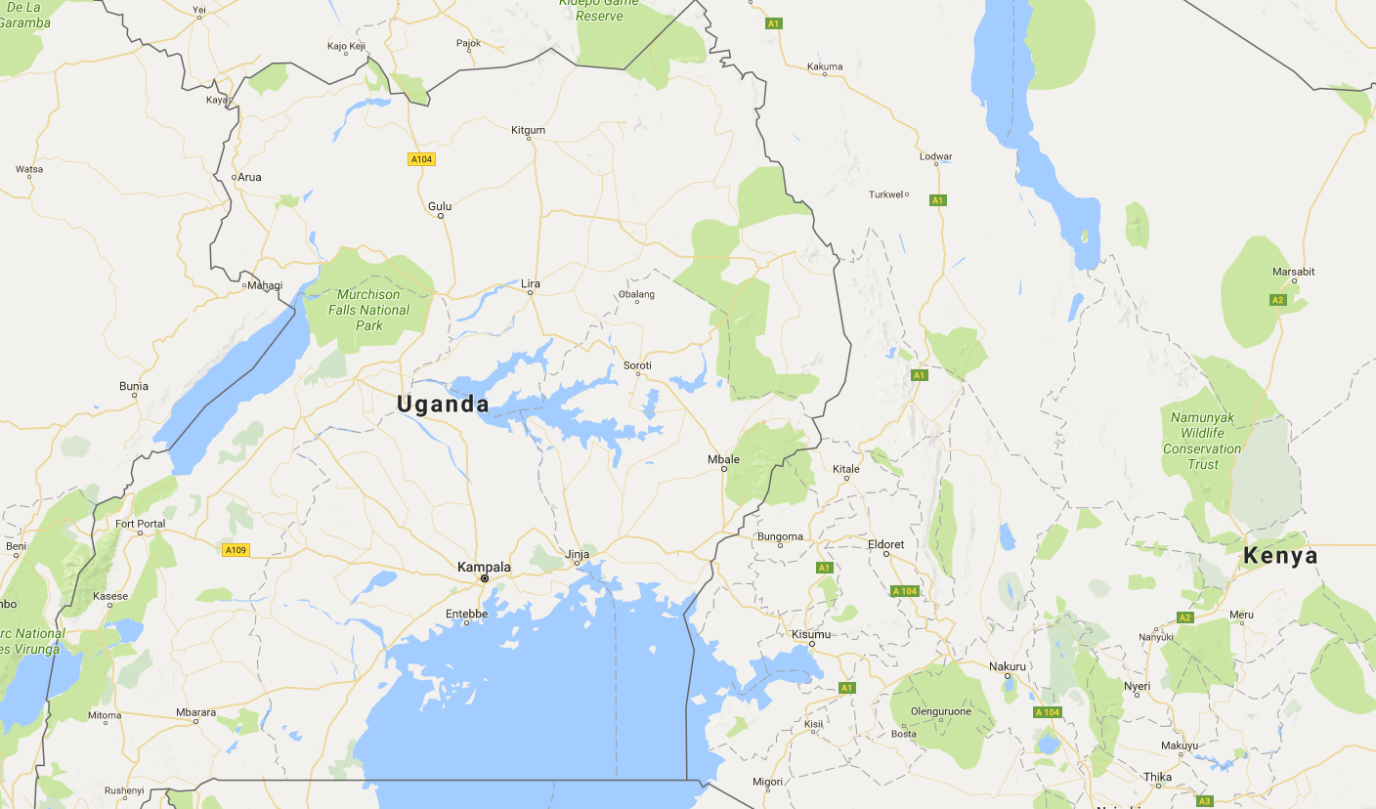
Sampling

Slide 11
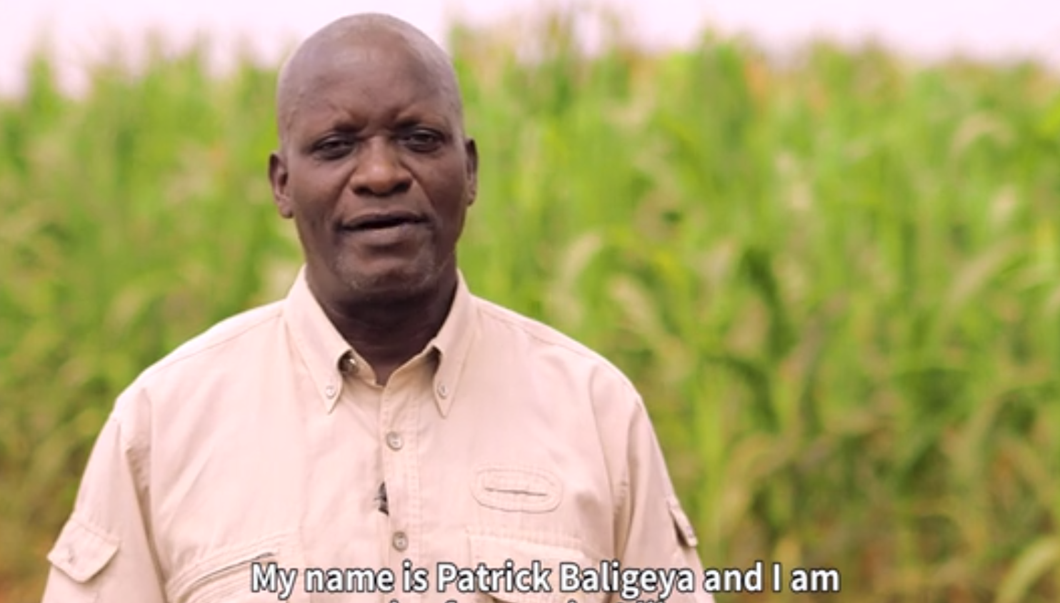
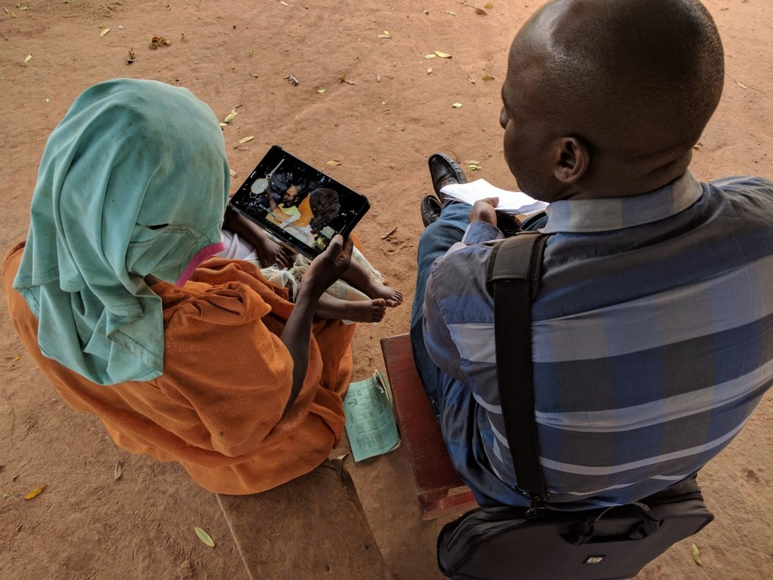
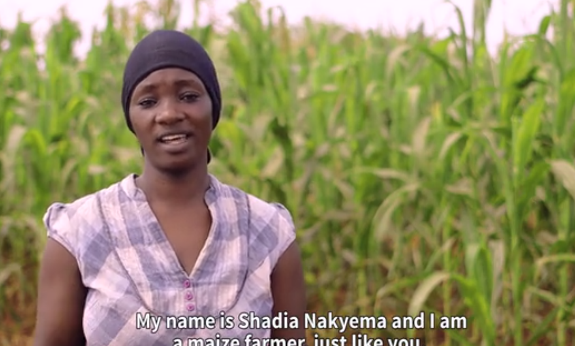
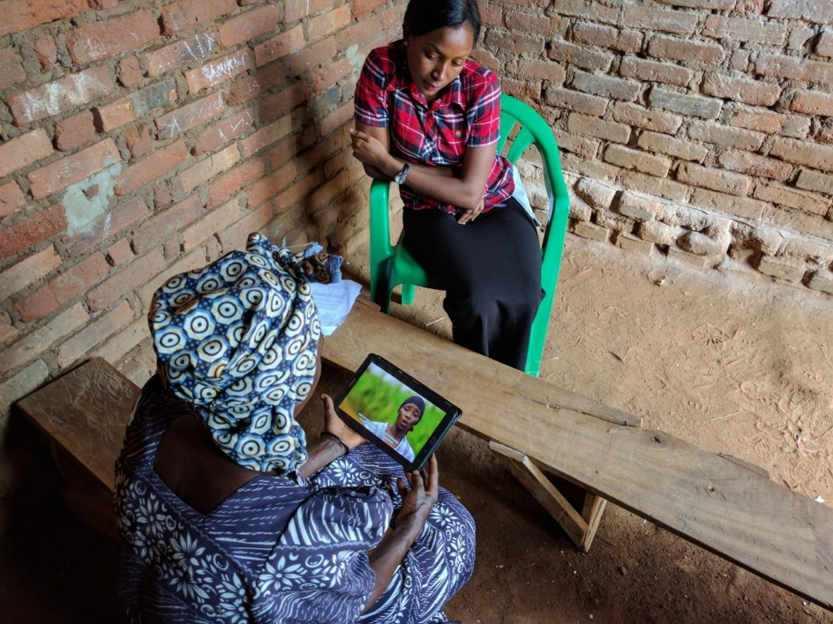
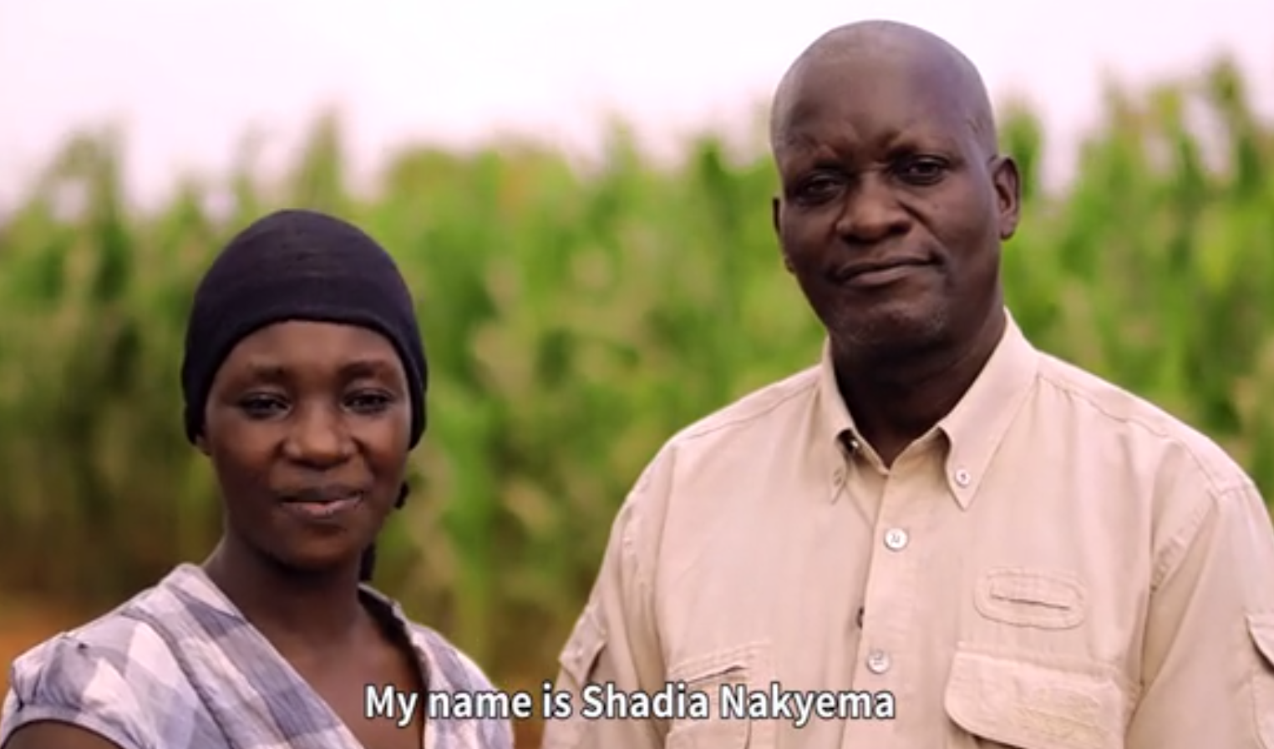
Treatments

Slide 12
Descriptive statistics and balance
 | average | treat vs ctrl | audience | messenger | matching
 |  | t-value (sig)
Yield (kg/ac) | 287.50 | -1.29 | 1.55 | -0.37 | -0.78
Age (years) | 39.76 | 0.80 | -6.39(**) | 0.27 | -0.38
Education | 36.75 | -0.01 | -5.26(**) | -0.63 | 0.02
HH size | 7.62 | 0.46 | -2.59(**) | 0.46 | -1.47
nr rooms | 2.24 | 1.09 | -1.40 | 0.53 | -1.84(+)
Extension (%) | 10.96 | -0.21 | 0.69 | -0.68 | 1.67(+)
Fertilizer (%) | 20.59 | -1.55 | 3.09(**) | 1.72(+) | 1.63
Seed (%) | 38.19 | -1.49 | 0.71 | 0.74 | 2.13(*)
Distance (km) | 5.50 | -1.16 | -0.60 | 0.55 | -0.92
# obs | 3,588 | 3,335 | 3,240 | 3,159 | 1,540

Slide 13
Does video increase knowledge?

Slide 14
Audience

Slide 15
Messenger

Slide 16
Gender matching

Slide 17


Present and Future
Currently second screening of the videos in the field
End line planned for January 2018 to collect data on a range of further outcomes, including:
HH level adoption, production and welfare
Intra-household outcomes – differential adoption, yield gap, WEAI,…
follow progress real-time on https://github.com/bjvca/maizeUG
AEARCTR-0002153

Slide 18

Thank you

